Slide 1
GeoKings
Design Review II
Team Members
Andrew Usvat
Zack Bryant
John Cardeccia
Jackson Brittain
Alex Poole
Client
United States Geological Survey (USGS)
Astrogeology Science Center

Slide 2
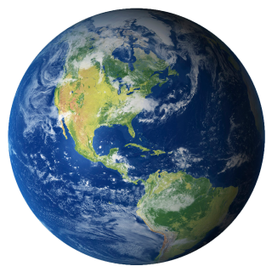
Big Picture
The universe extends over a radius of about 15 billion light years.
We want to increase space exploration.
Images and maps help increase exploration.
https://www.google.com/url?sa=i&url=https%3A%2F%2Fwww.freeiconspng.com%2Fimages%2Fearth-png&psig=AOvVaw1

Slide 3




Clients
usgs.gov
Amy Stamile Dr. Jay Laura Trent Hare
Software Developer Software Lead Cartographer

Slide 4
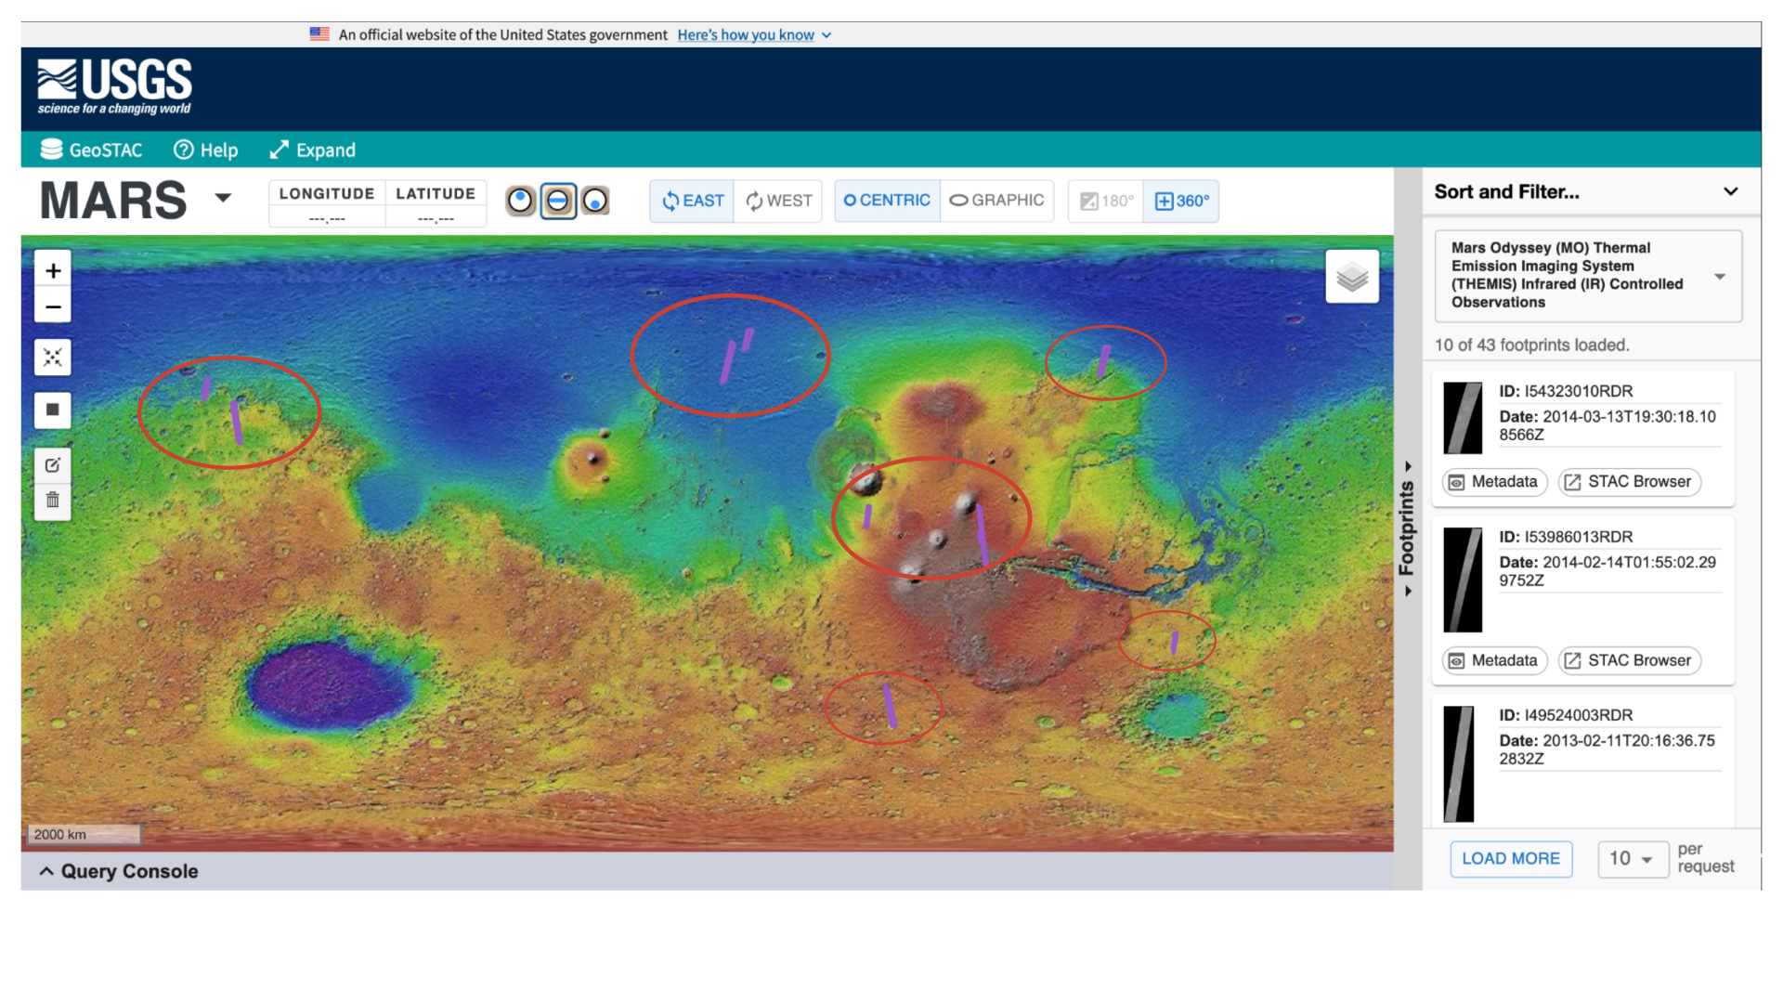
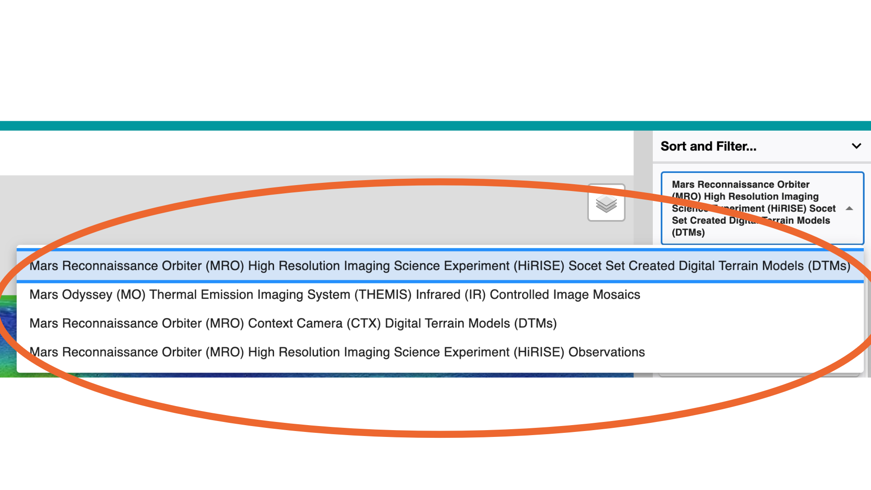
Problem
The current application uses only raster data.
Vector data is available but is not currently being used.
Stylization of footprints is currently very limited.
https://stac.astrogeology.usgs.gov/geostac/

Slide 5
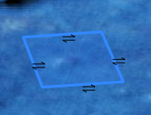
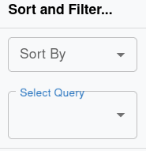
Solution
Integrating the the Vector API into GeoSTAC using PyGeo API software, and modifying the existing tools to work with the Vector API.
Using Leaflet to display vectors and Leaflet.SLD to style them
Creating compatibility with ElasticSearch and displaying to the website using React
Slip-Fault icons being displayed
Query selection box

Slide 6
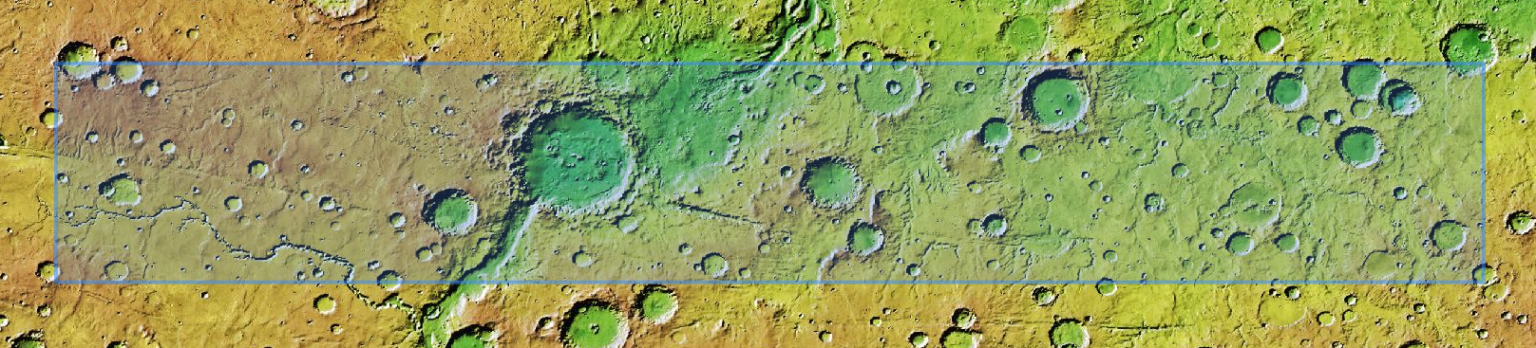
Implementation Overview
(Requirements)
Rendering
Stylizing
Searching
Access GeoJSON data through new Vector API.
Using SLD and SVG files to make the data useful.
Making the data accessible for the users.
*Mars GeoSTAC Web Application

Slide 7
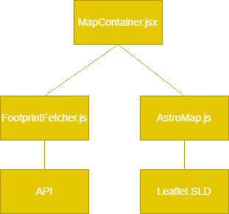
Implementation

Slide 8
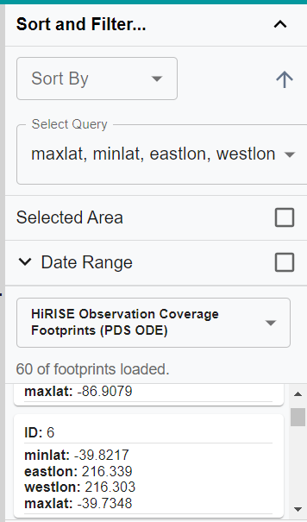
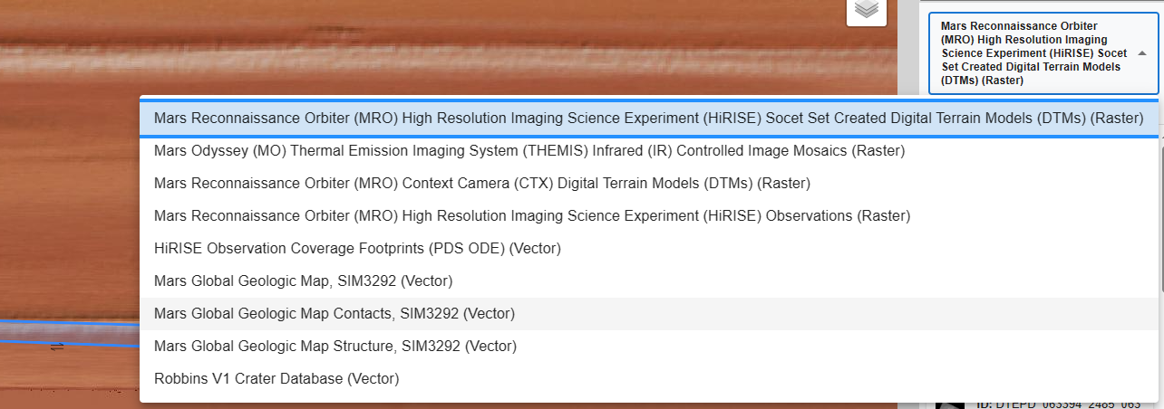
Implementation of API and searching

Slide 9
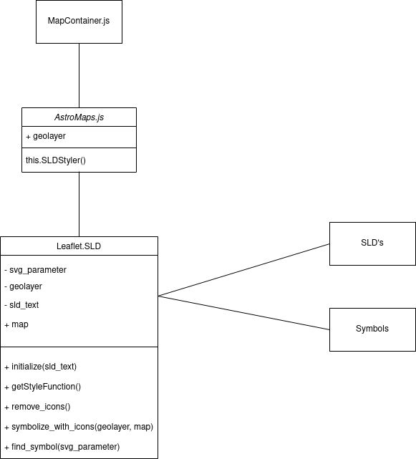
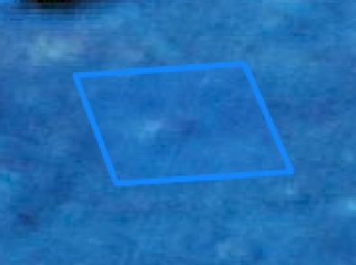
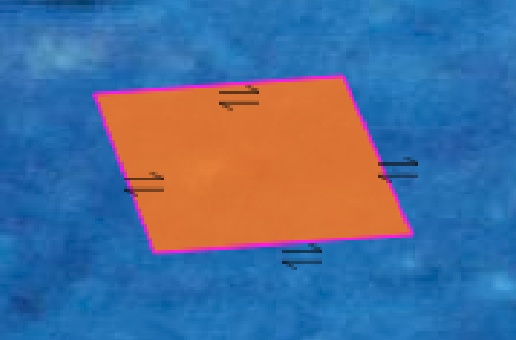
Implementation of stylizing/rendering
- Default GeoJSON style
- Custom GeoJSON styling with symbology

Slide 10
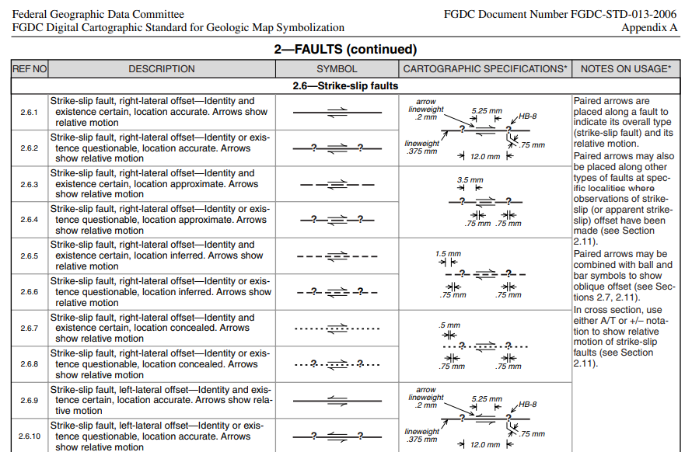
Challenges and Resolution

Slide 11
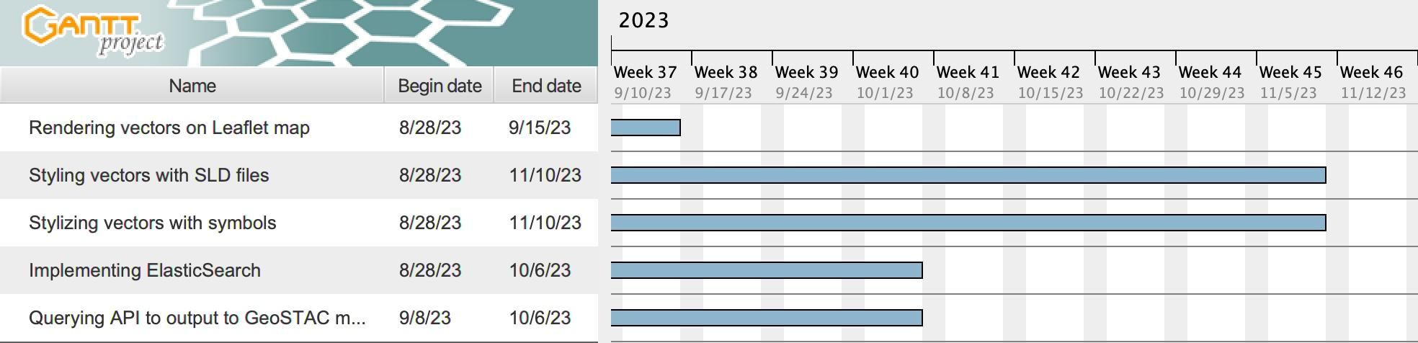
Schedule

Slide 12

Conclusion
Functional Requirements:
  Rendering, Stylizing, Searching.
Implementation:
  Rendering
    GeoJSON files using Vector API
  Stylizing
    Modified Leaflet.SLD functionality
  Searching
    Filterable attributes
Challenges/Resolution:
  Rendering SVG Icons

